Slide 1
Welcome to the sales-analyst-project
PROJECT BY - CHETAN

Slide 2
Dataset Overview
Key Features of the Dataset:
1. Product Information: Includes product categories and specific items sold.
2. Sales Data: Captures revenue, quantity sold, and transaction amounts.
3. Customer Demographics: Contains details such as age group and gender to analyze purchasing patterns.
4. Time-Based Insights: Includes timestamps to track sales trends over different periods.
Objective of Analysis:
1. Identify the best-selling product categories and their contribution to total sales.
2. Determine which age group and gender drive the highest sales.
3. Analyze quantity-wise sales trends to understand demand for different products.
4. Generate insights for data-driven decision-making and business growth strategies

Slide 3
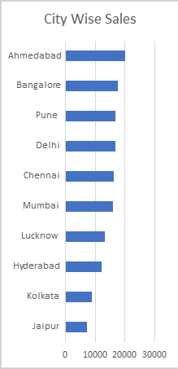
Q1. find the cities with the highest sales
Conclusion
Ahmedabad has the highest sales, indicating strong customer engagement or demand in this city.
Other major cities like Bangalore, Pune, Delhi, Chennai, and Mumbai show moderate sales suggesting stable performance across multiple location.
Kolkata and Jaipur have the lowest sales, which may indicate a need for targeted marketing efforts or lower customer demand in these cities.
Overall, sales distribution appears fairly balanced, with a few cities standing out as high-performance location.

Slide 4
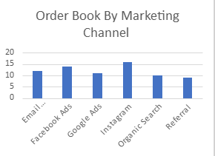
Q2. find name of the marketing channel that received the highest number of order book
Conclusion
Organic Search has the highest number of orders, indicating strong SEO efforts and customer searches leading to conversion.
Instagram and Facebook Ads are performance well, showing that social media marketing is an effective sales driver.
Googles Ads and Email marketing contribute a moderate number of orders, suggesting they are effective but cloud be further optimized.
Referral traffic has the lowest orders, which may indicate that word-of-mouth marketing or affiliate programs needs improvement.

Slide 5
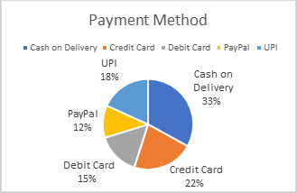
Q3. identify the most commonly used payment method.
Conclusion
Cash on Delivery is the most preferred payment method, indicating that many customers prefer to pay after receiving the product, possibly due to trust concerns or convenience.
Credit Card and UPI are also popular choices, reflecting a growing adoption of digital payments.
Debit Card usage is moderate, showing that some customers prefer direct bank transitions.
PayPal has the lowest share, suggesting limited use, possibly due to regional preferences or lack of awareness.

Slide 6
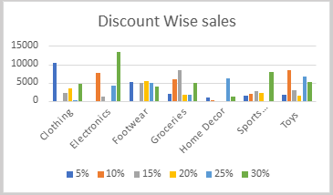
Q4. find which discount percentage has highest sales
Conclusion
Higher discount (e.g., 30%) generally lead to higher sales, as seen in categories like Footwear and Sports where sales peaked with maximum discount.
Moderate discount (10%-20%) also drive consistent sales, especially in categories like Electronics and Groceries.
Lower discount (5%) contribute to fewer sales indicating that customer are less attracted to minimal discounts.
The impact of discount varies by product category, suggesting that some items (e.g., Footwear, Sports ) benefit more from discounts than other (e.g., Home Décor).

Slide 7
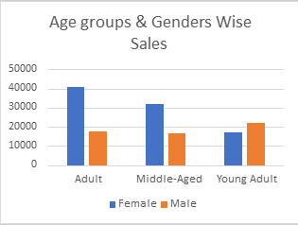
Q5. identify the age-group and gender with the highest sales
Conclusion
From the given chart, we can conclude that Adult females have the highest sales among the all age-group and gender.
The Middle-Aged female category follows closely in sales..
Among males, Young Adults have the highest sales, but overall, female sales outperform male sales in all age groups.

Slide 8
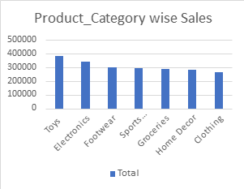
Q6. find the product category with the highest sales
Conclusion
From this chart, we can conclude that Toys have the highest sales among all product categories.
Electronics and Footwear follow closely behind. The sales across other categories such as Sports, Groceries, Home Décor, and clothing are relatively similar but slightly lower.
This indicates that Toys are the most popular or best-selling product category in this dataset.

Slide 9
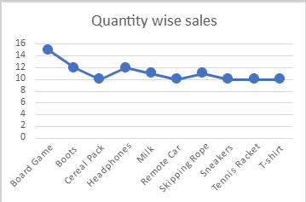
Q7. identify sales based on quantity
Conclusion
From this chart, we can conclude that Board game has highest quantity sales among all items.
Boots and Cereal Pack also have relatively high sales but are slightly lower than Board Games.
The sales quantities of other product such as Headphones, Milk, Remote car, Skipping Rope, Sneakers, Tennis Racket, and T-shirt, are relatively stable and similar.
This suggests that Board Games are the most in-demand product in terms of quantity sold.

Slide 10
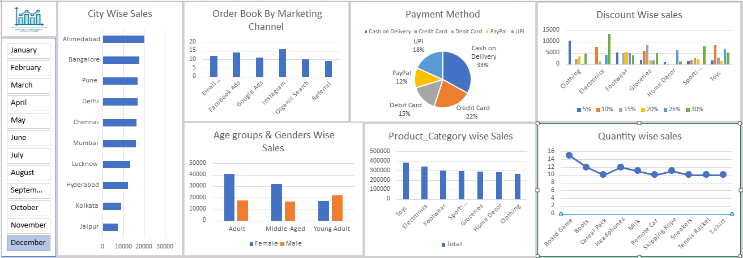
dashboard

Slide 11
THANK YOU

